Slide 1
Final Presentation
Jonathan Cheung
Alan Tokashiki
Samer Ye

Slide 2
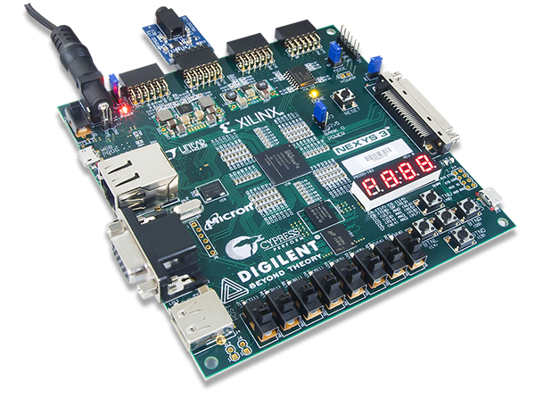
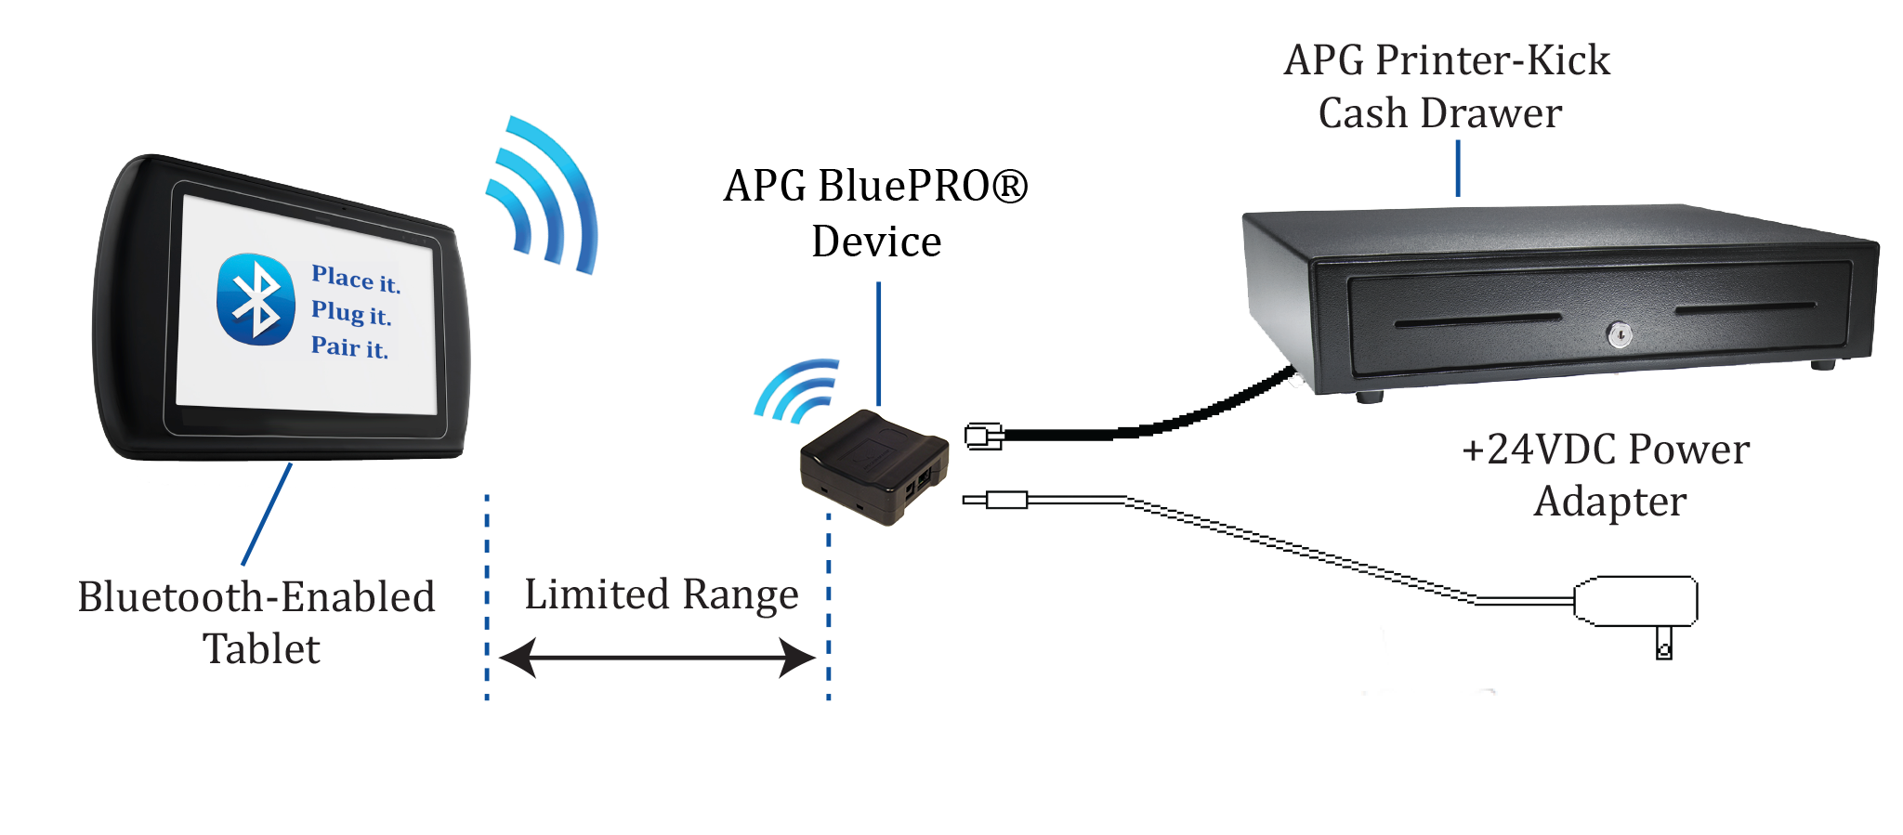
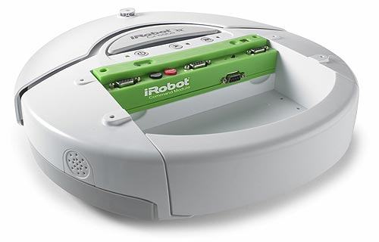
Introduction
Control iRobot wirelessly using FPGA
Gaming applications
Military applications (bomb disabling robot, drones, etc)
Opens up a new sector of wireless technology, many other applications

Slide 3
Real-world Constraints
Limited range of bluetooth
Different applications may need stronger forms of wireless communication than just bluetooth
Power constraints
FPGA must be tethered to power source, iRobot Create has limited battery -- must be recharged
Gyroscope without Accelerometer accumulates errors
Currently uses a laptop
Limitation of over-the-shelf products
iRobot Create: finite operations, limited movement
FPGA board: memory, peripherals, timing constraints
Ease of use
Consumer applications need to be have easy setup and use
Low cost to be affordable for mass production
Notes:
Physical limitations, end-user limitations, broad constraints

Slide 4
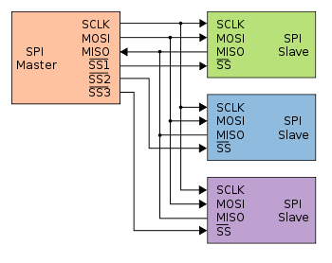
Industry Standards
Bluetooth
2.4 to 2.485 GHz
Max data rate and distances vary by version
Example: PMOD BT2 = version 2.1, class 2
2 Mbit/s
~10 meters
SPI Bus
Synchronous
Bi-directional
Master/Slave
PMOD Interface (supports SPI and I2C)
iRobot opcodes

Slide 5

Costs
Production
Bluetooth, gyroscope, FPGA
Requires a computer -- but could develop custom board
iRobot Create
Development
Programming, Set-up
Custom Parts for additional functionality or improved efficiency
Licensing of iRobot Create, Xilinx, Digilent etc.
Operation
Personnel
Maintenance, power
Marketing
Distribution

Slide 6
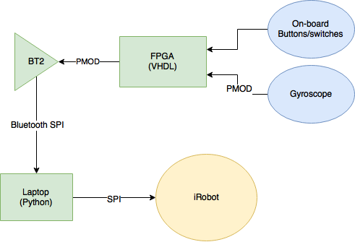
Project Description

Slide 7
Implementation Details
Hardware
Base: Nexys3 + Computer + iRobot Create
Peripherals: PMOD Gyroscope and PMOD Bluetooth
Software/Algorithms
VHDL
Read data from gyroscope
Process data
Write commands to bluetooth interface (FSM)
Python
PySerial library
Interpret commands (FSM + direct execution)
Translate to iRobot opcodes

Slide 8
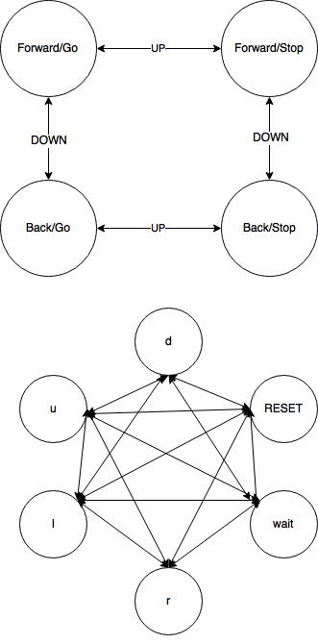
User
FPGA
Computer
u, d
u, d
Buttons
l, r
l, r
Hashmap
(command -> iRobot opcodes)
Gyro

Slide 9
Demo

Slide 10
Rubrics/Conclusions
Development problems
Learning VHDL
Bluetooth connectivity issues
Interpreting gyroscope data
Future Improvements
Improved fine-grain control over iRobot movement
More robust user input filtering
Adding accelerometer for more accurate gyroscope data
More commands
replacing the computer with a separate FPGA (or the like) to make the iRobot more portable
User interface
Has the potential for many applications

